Slide 1


Welcome To DevFest Manosura Hackathon 2024
OSC_Ninja

Slide 2

RawLink
connects factories with trusted suppliers, optimizing procurement and boosting Egypt's economy.
OSC_Ninja

Slide 3


Problem Definition
PROBLEM DEFINITION
Factories in Egypt often face challenges in efficiently sourcing raw materials and components. These challenges include:
Difficulty in finding reliable and trusted suppliers.
High procurement costs due to lack of price transparency.
Delays in material delivery, leading to production interruptions.
Limited visibility and analysis of supplier performance.
Inability to optimize procurement decisions based on market insights and supplier reviews.

Slide 4



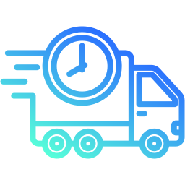
Raw link Solution
PROBLEM DEFINITION
A unified delivery service platform that connects factories directly with suppliers to streamline the process of ordering, delivering, and tracking materials
Unified Delivery Service Platform
Direct Connection between factories and suppliers
Direct Connection between factories and suppliers
Real-Time Shipment Tracking for better visibility

Slide 5
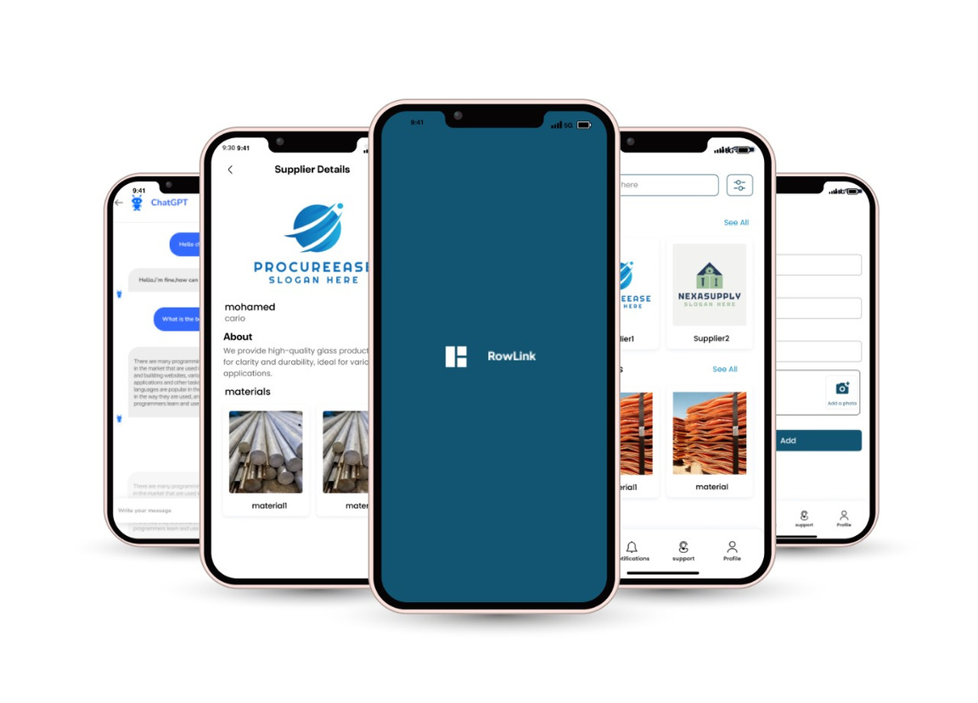
Prototype
"The app's design prioritizes ease of use and efficiency, offering real-time updates, streamlined order management, and seamless communication between suppliers and factories to improve operational flow."

Slide 6
BMC
PROBLEM DEFINITION
Problem
Soluation
Inefficient delivery and supply chain management:
Delays in receiving raw materials and equipment.
Difficulty finding reliable suppliers and managing multiple sources.
Lack of real-time tracking and visibility of deliveries.
A unified delivery service platform:
Connects factories with suppliers for raw materials, machinery, and other resources.
Real-time tracking of shipments and status updates.
Simplified communication between factories and suppliers.
Add Value
Target Audience
Improved delivery speed and reliability: Fast, on-time deliveries for factories.
Enhanced tracking and transparency: Real-time updates and notifications.
Streamlined supply chain management: Unified platform for sourcing and managing resources.
Factories and manufacturing plants needing consistent and timely deliveries.
Suppliers of raw materials and machinery looking to streamline their delivery process.

Slide 7

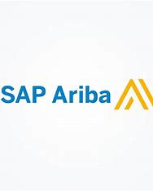
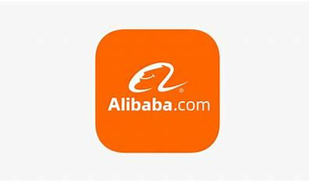





COMPETITORS & MARKET LANDSCAPE
PROBLEM DEFINITION

Slide 8

Competitive Analysis
AMAZON BUSINESS | ALIBABA | SAP ARIBA | OUR SOLUTION
REAL-TIME TRACKING
INTEGRATION WITH LOGISTICS
MARKET INSIGHTS
COST EFFICIENCY
E-COMMERCE & BULK PURCHASING

Slide 9

INVESTMENT ASK
PROBLEM DEFINITION
Investment Ask :
Seeking 300,000 L.E to scale marketing, product development, and customer support.

Slide 10
INVESTMENT ASK AND EQUITY OFFER
PROBLEM DEFINITION
Use of Funds:
Break down how the investment will be used. This should be tied to growth and revenue generation.
Product Development: “50% of the funds will go towards improving the user experience with a seamless interface, easy order management, real-time tracking
Marketing and Sales: “30% will be allocated to expand our reach through digital marketing and partnerships.”
Miscellaneous Costs: “20% for for operational costs to run a small team for managing operations and customer communication.

Slide 11
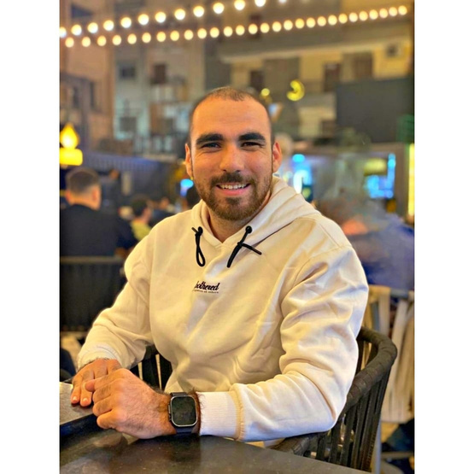
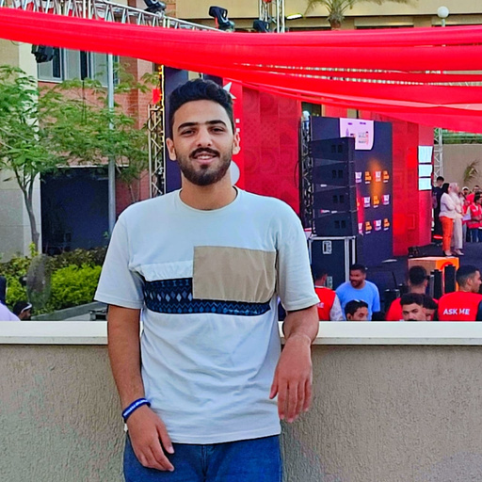



Our Team
Ahmed ElSany
Ahmed Samir
Marwa Mohamed
Mohand Adel
Mohamed Nasr

Slide 12
THANK YOU
FOR WATCHING

Slide 13
BMC
PROBLEM DEFINITION
Key Partners
Key Activities
Value Propositions
Customer Relationship
Customer Segments
Suppliers of raw materials
Logistics Companies
Market Research firms
Payment Processors
Supplier Onboarding
Data Analysis
Customer Support
For Factories:
Reliable supplier network
Real-time tracking of orders
Market insights for better purchasing decisions
For Suppliers:
Access to new customers
Reliable customer feedback
Personalized Support
Self-Service
Community Feedback
Factory Owners & Managers
Manufacturers & Industrial Companies
Local & International Suppliers
Key Resources
Channels
Technology Infrastructure
Marketing & Sales Team
Market Data
Mobile App (iOS & Android
Email and Customer Support Lines
Social Media
Cost Structure
Revenue Stream
Development & Maintenance
Marketing & Advertising
Transaction Fees
.Logistics Integration
Transaction Fees
Subscription Fees
Advertising

